Slide 1

Tennessee Tech ECE 1000 Final Project Robot Arm
ECE 1000: Explorations in ECE
Electrical and Computer Engineering
Tennessee Tech University
April 25, 2024

Slide 2
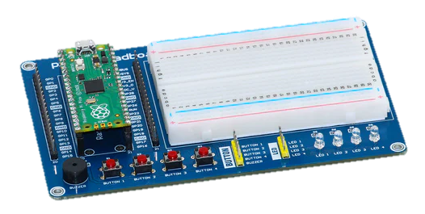
Look at the Microcontroller
Used Raspberry Pi Pico Microcontroller
Programmed using Python
It tells the servos what to do

Slide 3
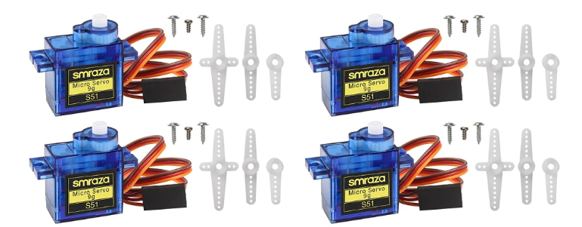
Look at the servos
Controlled three 9g Micro servos.
They are what makes everything move.

Slide 4
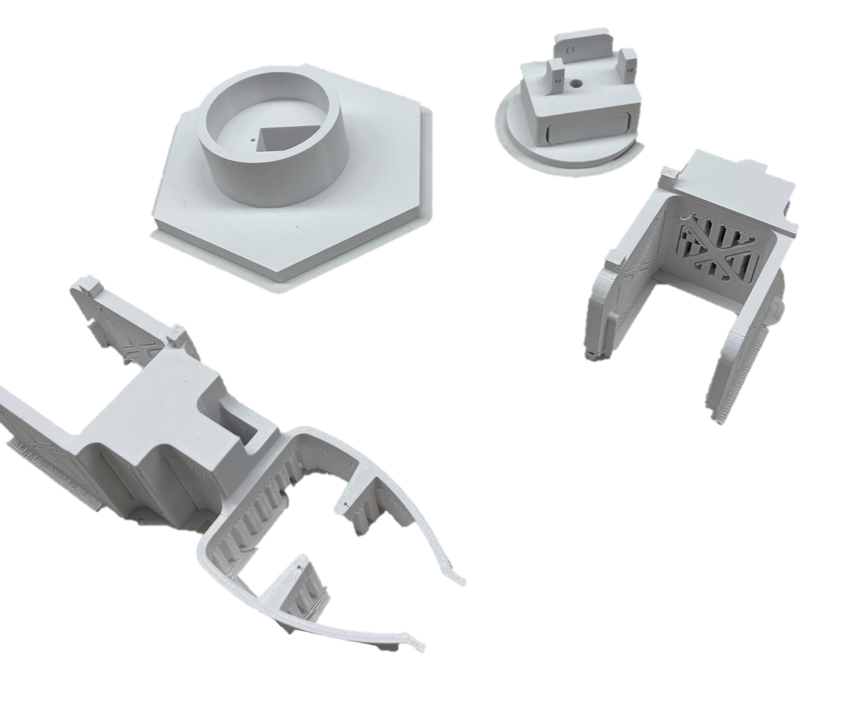
3D-prints
Used 3D printed frame to construct robot arm.
Printed parts separate, assembled by removing print supports and putting in servos.

Slide 5
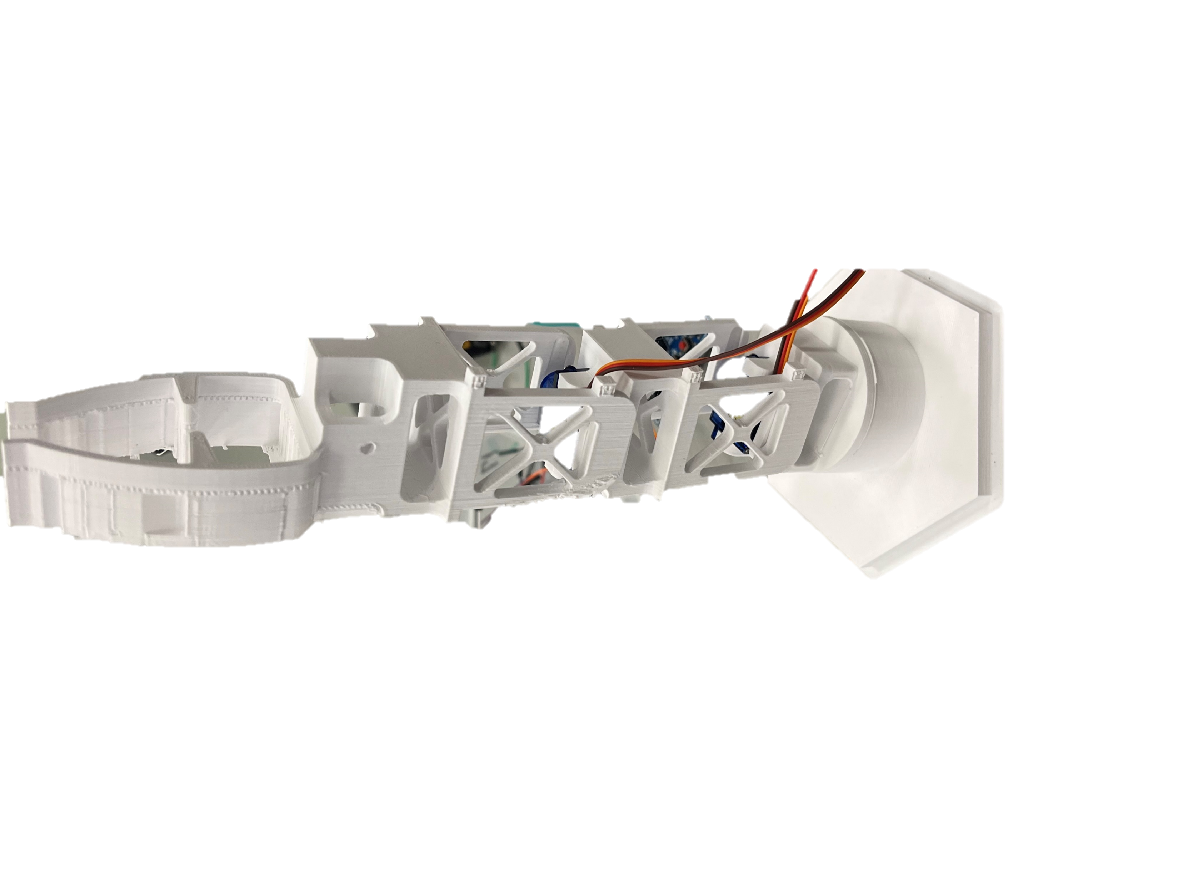
Initial assembly
These prints are the parts to be moved and do work
Horizontal view
Vertical view

Slide 6
Coding in Python
Used Thonny, a Python IDE
Code is how the Pi tells the servos what to do
It works based on the position of the joystick sensor
It can move 3 servos using the X-, Y-, and Z (button) directions.

Slide 7
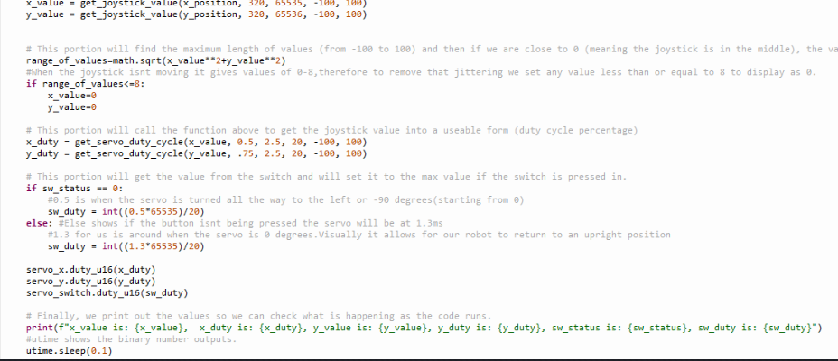
Coding Example
Here is a snippet of our code (for more details, refer to our GitHub):

Slide 8
Final Assembly
We wired the servos’ power connections to the Pi using the breadboard
Servo’s power wires connected to board’s 3.3V pin
Ground wires connected to board’s ground
The laptop acts as power supply and allows the joystick’s positions to be displayed
An additional power supply was unnecessary due to the minimal requirements of the small 9g servo motors.
We connected the servos’ signal wires to the board’s signal pins as appropriate for our code

Slide 9
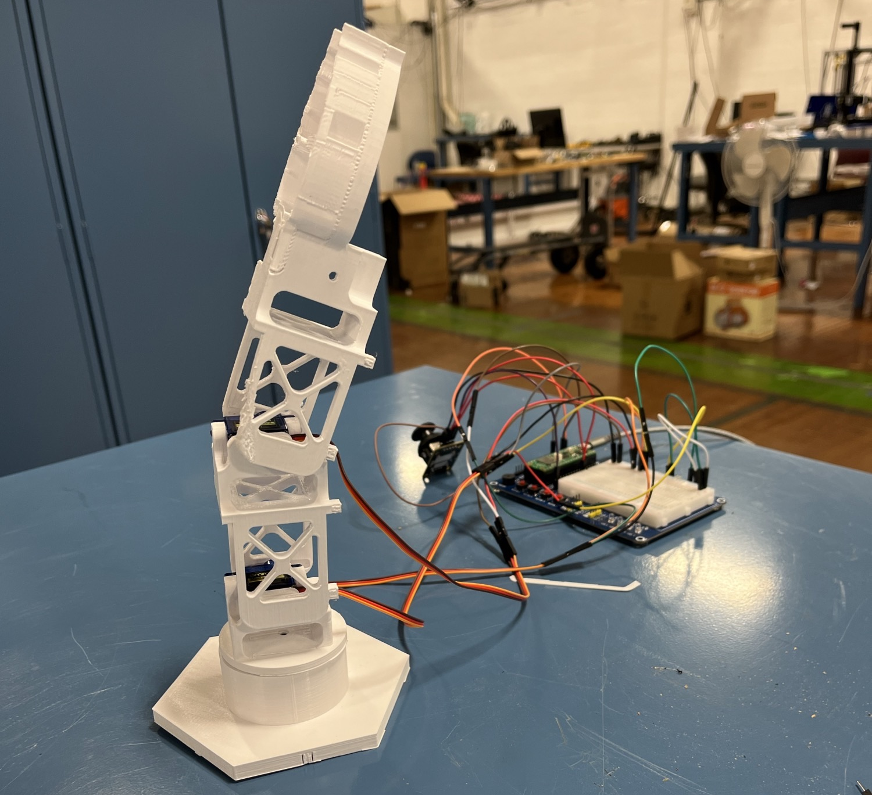
Final Assembly (pictures)

Slide 10
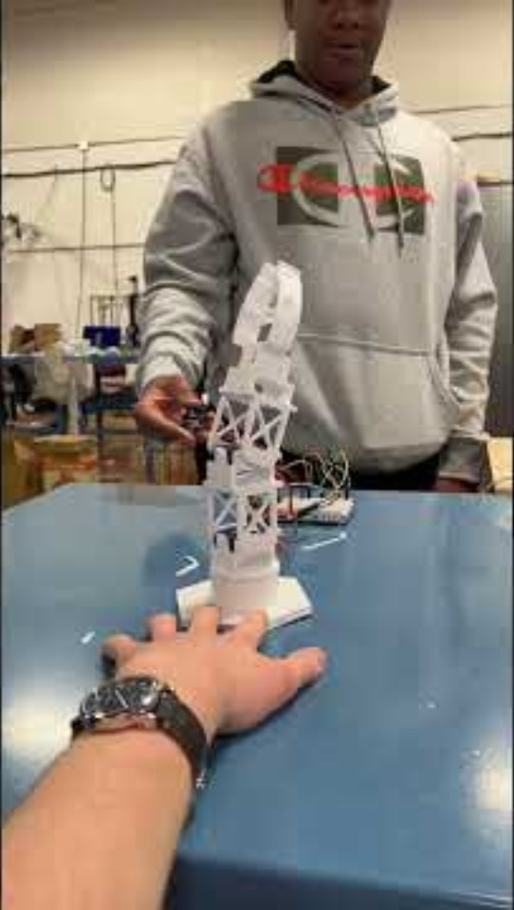
Demonstration Video
ECE1000FinalProjectRobotArm (youtube.com)

